Slide 1
Hands-on Minds-on Teaching with SpEd Helper Aligned
July
2022
STAAR-Alt Helper
cindy@cindylovelace.com
Cindy Lovelace

Slide 2
You should know!
I BELIEVE
SPECIAL EDUCATION
MUST BE SPECIAL
Notes:
One problem we have as lid teachers is that we are not taught to teach academics effectively to special education students.
If we teach like regular ed teachers, then our students will not learn.
Our students learn differently so we MUST teach differently. Special Education MUST be SPECIAL!

Slide 3
Hands-on Minds-on
How does it work?
Students Must
See it, Hear it,
Feel it!
Many times!
Many ways!
Provides Active Lessons
Use Hands-on Instruction
Engages Students
Provides Concrete Lessons
Expects All Students to Learn
Notes:
Hands-on Minds-on
Provide Active Lessons. Nothing is worse than a bored student.
Use hands-on instruction. This isn’t coloring a page while others do work -How boring is that?
This means the student must see the lesson, hear the lesson and touch the lesson.
What about Minds-on? Have you ever driven to work on a Saturday by mistake? Your brain was not engaged in what you were doing. Call students by name. I learned that most of my students did not know that “All of you! Meant every one of them.” So, if a student is not aware of what is going on, call his name. Get his mind going in your direction.
Most IMPORTANT: Teachers teach concepts, teacher assistants, aides, helpers -whatever- provide support and training or review. It is your responsibility to teach.

Slide 4
Chanting!
We will
SEE IT! HEAR IT! FEEL IT!
SEE IT! HEAR IT! FEEL IT!
SEE IT! HEAR IT! FEEL IT!
SEE IT
HEAR IT
FEEL IT

Slide 5
Why are Concrete Lessons Important?
Concrete Representational Abstract
Teach using different real-life manipulatives.
Allow lots of practice with manipulatives.
Introduce pictures to
represent objects
Provide lots of practice on the concept using pictures of objects
Teach concept using only numbers & symbols.
Provide practice using
only numbers & symbols
Mom with son in class Picture of his Mom Icon of a mom
Notes:
Concrete Representational Abstract (CRA) is a three-step instructional approach that has been found to be highly effective in teaching math concepts.
The first step is the concrete stage. It is known as the “doing” stage and involves physically manipulating objects.
The representational (semi-concrete) stage comes next. It is known as the “seeing” stage and involves using images to represent objects.
The final step in this approach is the abstract stage. It is known as the “symbolic” stage and involves using only numbers, letters and symbols.
CRA is a gradual systematic approach. Each stage builds on to the previous stage and therefore must be taught in sequence. This approach is most used in elementary grades, but should also be used in some middle and high school classrooms with low level students.

Slide 6
TEKS for All

Slide 7
Help for Drowning Teachers
SpEd Helper Aligned
Prepared Lesson Plans
Activities with Hands-on Lessons
Materials that Work
Student Progress Reports
http://www.staar-alt.com/SpEdHelper.htm

Slide 8
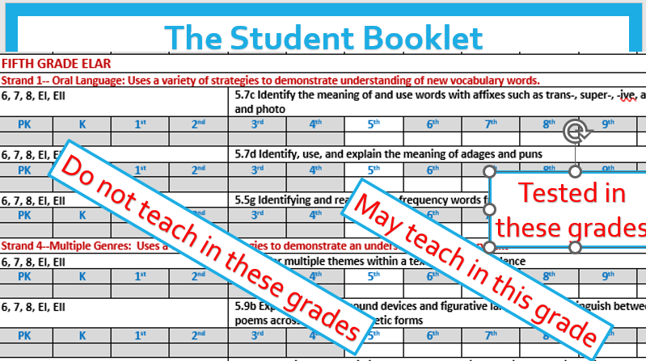
SpEd Helper Aligned
Notes:
The Materials Mats have always been the core of the lessons.
There are enough materials to help the teacher learn how to teach using the methods described. With many of my students using the mats in different ways was enough for them to generalize the skill with other materials.
The Mats are no worksheets and are not to be used as independent work until the student knows how to do the skill.

Slide 9
Student Report Booklet
John Doe 7/14/2008
W w m
W m R/M
W m
M
M
w M
W
w w
John is a in the 4th grade working at the 2nd Grade Level in Science but in the 1st grade level in Reading and Math
Notes:
Do not teach a skill before it is taught in regular education. If a student can do that skill, he needs to be in regular ed.
The white area shows the grades that a skill should be taught. Now the next colored area shows the grades tested..
This slide shows what it would look like marked up.
One teacher needs to always use one color. Black, Blue, Red, Purple then back to black so that a new teacher can easily see how long it has taken for a student to learn a skill.
Determine what the student can do then mark it with an M for Mastered
Determine what the student will work on next. Mark with a W for Working
Mark an R for Regressed if a student cannot do a Mastered Task after a break
Mark a D for discontinued or deleted if a student cannot master a skill.
Non-Verbal can’t do consonant sounds
Has not arms can’t stack blocks
Blind so can’t Read unless you teach braille
Shakes violently so cannot scoop or measure but can identify measures.

Slide 10
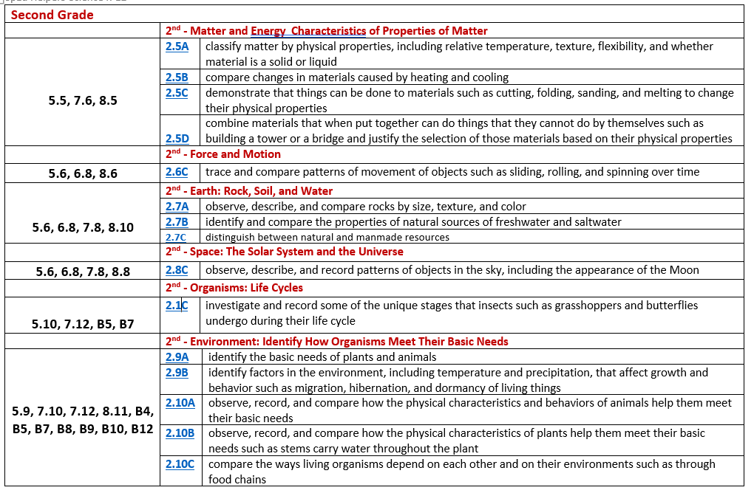
The Alignment
Notes:
I wrote the first STAAR-Alt Helper in 2012 to go with TAKS Alt.
Then revised it in 2015 to fit STAAR-Alt 2
I spent the 2 years of COVID writing SpEd Helper Aligned to answer teachers most important questions.
What do I teach and Where do I start.
The Alignment at the front of each topic, ELAR, Math, Science and Social Studies looks like this.
It will show the Regular Ed grade level
The regular ed TEK
The Special Education TEK and/or grade level tested.
And it shows the exact wording of the TEK and Prerequisite skill to match it.
ELAR has up to some 5th grade TEKS
Eventually, the TEK numbers will change but these skills will never change. They are the basic skills in the order they should

Slide 11
The Lesson Plan
Notes:
Most Lesson Plans have the same parts and the same format.
You can see that they have the RegEd TEK, SpEd TEK, Objective and Materials list or links. The Activities and Instructions are specific to hands-on teaching. Cindy’s Notes which are personal information that I think will help. Often, the definition of words and how the lesson can go wrong, usual it is User Error (MINE). Then there is Differentiation for 3 types of students and how you might teach them differently.
I kept all my materials in File folder “Games” with the lesson plan on the outside. I used lots of Velcro and card stock but it was worth it. After a few years, we could start teaching day one.
Then, there are the activities and links. I hate to say it but some of the links have become pay or do not exist. Everything goes away sometime.
There is a section that shows how you can differentiate for the different levels of student ability.
As teachers we differentiate all the time. But we are supposed to have how we will do it on our lesson plans.
ELAR 80 Lesson Plans, Math 130 Lesson Plans
Science 74 Lesson Plans Social Studies 52 Lesson Plans

Slide 12
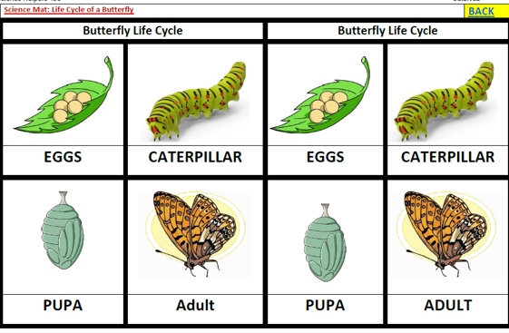
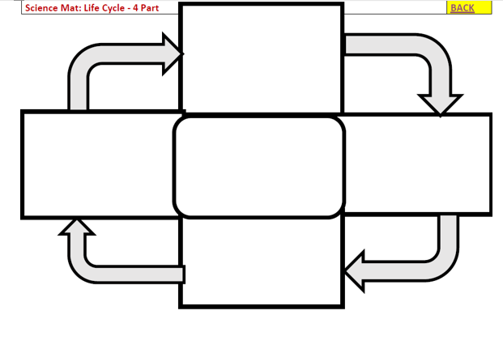
Teaching the Lesson
Hold up the card. Say “First comes the butterfly. Say Butterfly”
Show me (Touch) the Butterfly picture.
Repeat with each picture, starting with the first picture.
See the chart? Students touch the chart.
Put the title of the chart in the middle. (Either copy it or glue it depending on the skill.)
Put the pictures in order on the chart.

Slide 13
Hands-on Minds-on
Engage Students as much as possible.

Slide 14
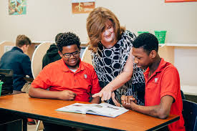
Questions?
Cindy Lovelace
972-935-3293
cindy@cindylovelace.com
www.staar-alt.com
Come by our Booth

